Slide 1
Real-Time Settlements Review
Rodney Jackson
Sr. Client Trainer
August 25, 2021
The information contained in these materials is provided for general information only and does not constitute legal or regulatory advice. The ultimate responsibility for complying with the ISO FERC Tariff and other applicable laws, rules or regulations lies with you. In no event shall the ISO or its employees be liable to you or anyone else for any decision made or action taken in reliance on the information in these materials.
Notes:
Welcome to the California ISO! Today’s quarterly webinar is scheduled for 2 hours and is intended to provide an introduction to an audience that comes from a broad spectrum – from energy sector newcomers to public officials and regulators, to ISO veterans who may already be familiar with various ISO functions.
My name is Rodney Jackson, Senior Client Trainer in the Customer Readiness department, and I will be facilitating the first part of today’s discussion. With me is Heidi Carder, Senior Client Trainer who will be facilitating the later part of today’s webinar.
On behalf of the ISO, thank you for joining us today.

Slide 2
What we will cover today
Background
New Process
Impact
Questions
Resources
Wrap Up
Notes:
Our agenda today will look like the following:
We will talk about how CAISO breaks down training and what you can expect going forward with CAISO. You will learn what the CAISO is and what it does. You will become familiar with Pre-Market activities. Once those events have completed, we will learn about Market and Post-Market activities. In order to solidify your learning, you will get a chance to apply what you have learned today then we will wrap up class.
Section about Market SIM – scenario
Try it with CAISO settling and without

Slide 3
Housekeeping
Make sure to keep yourself muted unless you have a question
If you have a question, you may either ask over the phone or in the chat
If you want to ask a question or comment, you can virtually “raise your hand” in WebEx
Notes:
VIRTUAL NOTES
To ensure we

Slide 4
What changed?

Slide 5
The Background
What is the current process?
CAISO settles Unaccounted For Energy (UFE) for all EIM entities
What is changing?
How individual EIM entities can settle their UFE
What prompted this change?
An EIM entity requested to allow entities to elect how to settle UFE
Notes:
What is the current process? CAISO currently settles unaccounted for energy for all utility distribution company (UDC) within an EIM BAA, which results in a charge or credit to the affected EIM entity.
What is actually changing? EIM entities can choose whether or not to have CAISO settle their UFE.
So why was there a need for a change? This was a request brought up at an EIM quarterly meeting by the EIM BAAs to consider allowing the entity to select whether or not to settle Unaccounted For Energy (UFE). Because of the request, the ISO conducted some research and proposed a solution for UFE settlements.
Who is eligible?
There are some instances where EIM entities do not have a complete set of load meters on the distribution system. Therefore, the CAISO made some accommodations to EIM entities that need to measure demand using a load derivation approach. In the load derivation approach, the EIM entity scheduling coordinator indirectly derives their load using measurements from internal generation and intertie meters and applying a transmission loss factor. The CAISO believes it is beneficial to offer EIM entities the option not to settle UFE when they derive their load meter values using a load derivation approach. Therefore, the CAISO proposes a market rule change that will allow an EIM entity the option not to settle UFE if they use a load derivation approach

Slide 6
The Change
What is the change?
EIM entities can self schedule losses
What is the new process?
EIM entities can elect annually to have CAISO settle UFE
Notes:
What is the change? Allows EIM entities to self schedule losses associated with base schedules as well as incorporate RTM loss within the load Uninstructed Energy Imbalance (UIE) settlement.
What is the new process? An annual election process occurs each November for trade dates of January through December for the following year. For the trade period of November 1 2021 and all of 2022, CAISO needs the election letter received by September 1, 2021. If not selection is made by this date, the default choice will be for CAISO to continue to settle UFE as it does today.

Slide 7
The Election Process
What is the election process?
EIM entities must submit a CIDI ticket with attached UFE Election letter
The subject line must read: UFE Election
EIM entities will be notified through current CIDI ticket process
What is in the letter?
Use the template included in this presentation to properly format your letter

Slide 8
The Election Process
Annual UFE Election Letter for 2021: Due by 9/30/2021
EIM Entity Name and Address.
Subject: UFE Elections - 2021
Pursuant to CAISO Tariff Section 29.11(c) (2) (B), [insert EIM Entity Name] makes the following UFE Elections for Trade Dates 11/1/2021 - 12/31/2021.
UFE Settlement Election: Yes (settle) or No (do not settle).
Loss Factor:
If UFE Settlement Election is Yes, please provide the OATT Loss factor or agreed upon loss factor percentage.
If UFE Settlement Election is No, enter 0%.
Please contact [insert contact name and info] with any questions.

Slide 9
The Election Process
Annual UFE Election Letter for 2022: Due by 10/31/2021
EIM Entity Name and Address.
Subject: UFE Elections - 2022
Pursuant to CAISO Tariff Section 29.11(c) (2) (B), [insert EIM Entity Name] makes the following UFE Elections for Trade Dates 1/1/2022 - 12/31/2022.
UFE Settlement Election: Yes (settle) or No (do not settle).
Loss Factor:
If UFE Settlement Election is Yes, please provide the OATT Loss factor or agreed upon loss factor percentage.
If UFE Settlement Election is No, enter 0%.
Please contact [insert contact name and info] with any questions.

Slide 10
The Election Process
UFE Election Due Dates:
Market Sim: Market Sim team will communicate the election due date through MSIM meetings.
Annual Election for 2021: UFE Election letter due by 9/30/2021. This covers Trade Dates from 11/1/2021 through 12/31/2021.
Annual Election for 2022: UFE Election letter due by 10/31/2021. This covers Trade Dates from 1/1/2022 through 12/31/2022.
Notes:
Question) If EIM entity misses submitting the UFE Election letter by deadline, what will be the impact?
Response) The default elections will be used; the entity will be subject to UFE Settlement.
Question) If the EIM entity selects the “not to settle UFE” option for Market Sim and if they want to change it to “yes settle”, can we change it?
Response) Yes, you can make election changes once between Market Sim and Go-live effective Trade Date (11/1/2021).
Question) How do I submit my UFE Election Letter in Production?
Response) Please submit the UFE Election Letter as an attachment via CIDI. The letter should be on company letterhead and is required with a signature from the company management. The Deadline is 9/30/2021 for election year 2021 and 10/31/2021 for election year 2022.
Question) In light of everyone working remotely, would CAISO accept an electronic signature instead of an actual one? I am thinking that not everyone may have a scanner at home for scanning a signed document. It seems that an electronic signature becomes more and more acceptable.
Response) Yes, electronic signature for this purpose is acceptable.

Slide 11
The Impact
What are the impacted charge codes?
Real-Time Imbalance Energy Offset (CC64770), Real-Time Congestion Allocation Offset (CC67740), Real-Time Marginal Loss Obligation (CC69850), UFE (CC64740), UIE (CC64750).
What is the impact to Operations?
Load case schedule calculations will be 0% loss factor
What prompted this change?
An EIM entity requested to allow entities to elect how to settle UFE
Notes:
What is the impact to Operations? If the entity elects to NOT have CAISO settle UFE, then BSAP will apply 0% loss factor when calculating load base schedule. The EIM entities also need to use 0% loss factor when calculating the load meter.

Slide 12
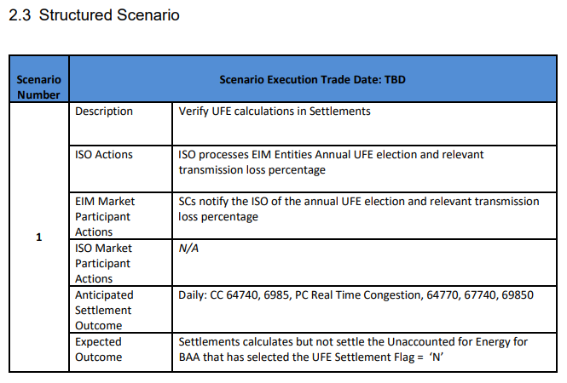
Market SIM Scenario
Market SIM Scenario
Notes:
During Market SIM, we will run two scenarios. The first one is set to default, yes. Then it will be run again with the flag set to no. You must submit a CIDI ticket to change the UFE Election flag to “N” to not settle.

Slide 13
Questions
Notes:
-- LET’S PAUSE HERE FOR A QUESTION BREAK –

Slide 14
For more Information…
Notes:
Where can you go to find more information?

Slide 15
Links to Resources
Please review the Draft Final Proposal in the below link.
https://stakeholdercenter.caiso.com/StakeholderInitiatives/Real-time-settlement-review
Please review the Draft Technical document posted for fall under Release Planning section of the CAISO website.
http://www.caiso.com/informed/Pages/ReleasePlanning/Default.aspx
Please review the Business Requirements Specifications under Release Planning section of the CAISO website.
http://www.caiso.com/Documents/BusinessRequirementsSpecification-Real-TimeSettlementReview.pdf

Slide 16
We’d like to hear from you
For more detailed information on anything presented, please visit our website at:
www.caiso.com
Questions or suggestions for future trainings? Email us at:
CustomerReadiness@caiso.com
Notes:
-- WRAP UP –
If you have questions on anything presented here today, or where to find more information, please email them to CustomerReadiness@caiso.com.
For those who signed in to today’s webinar, you will be receiving an email from CustomerTraining@caiso.com that will include a link to a survey. We highly encourage you to take a few minutes to complete the survey to let us know how we can better serve your training needs!
This concludes our session today. Thank you for your participation. We hope you found it useful and informative. Have a great day!
-- END --

